Slide 1

Introduction to MLOps

Slide 2
Agenda
Motivation
What is MLOps?
Practices
Components
Tools

Slide 3
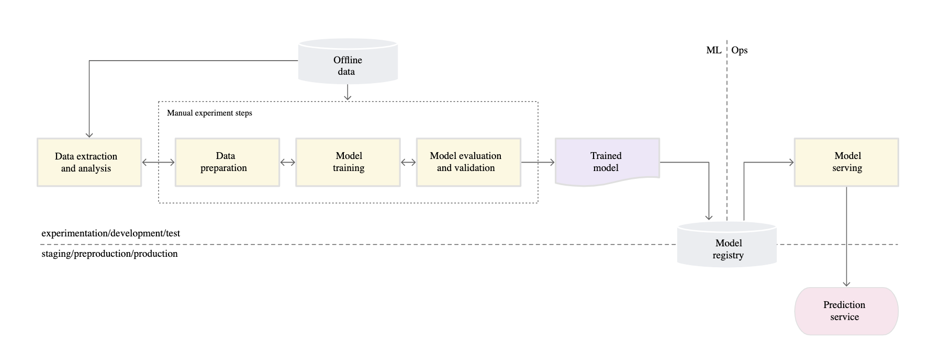
Machine Learning Workflow

Slide 4
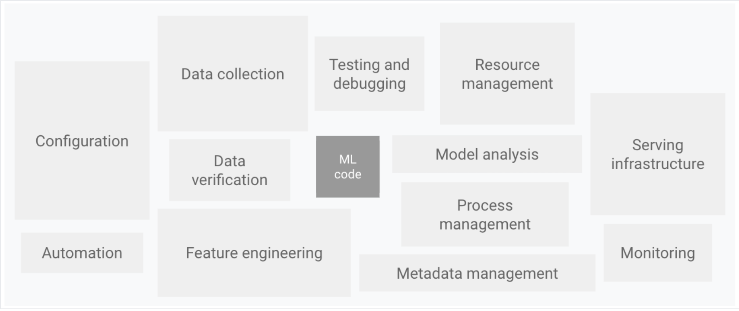
Machine Learning System

Slide 5
According to report, 2020 State of Enterprise Machine Learning, only 22 percent of companies that use machine learning have successfully deployed an ML model into production.

Slide 6
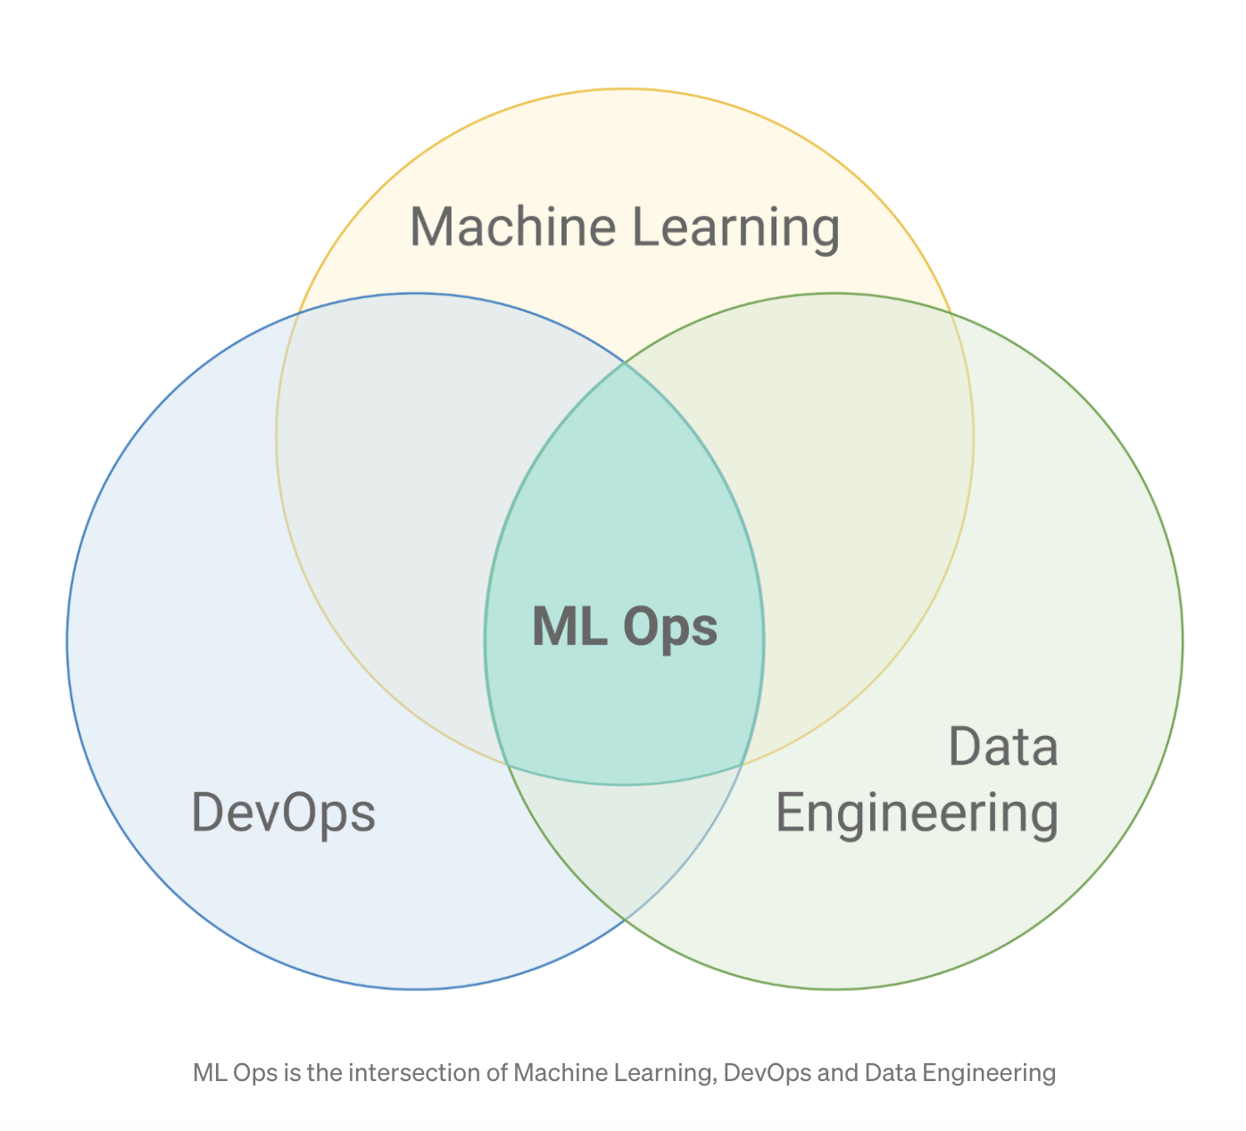
What is MLOps?
MLOps is a practice for collaboration and communication between data scientists and operations professionals to help manage production ML lifecycle.

Slide 7
Practices in MLOps
Model, Data and Hyperparameters Versioning
Deployments and Automation
Testing (Unit, Integration)
Security
Production Monitoring
Infrastructure Requirement

Slide 8
Automation
Manual Process
ML Pipeline Automation
Continuous Integration / Continuous Delivery

Slide 9
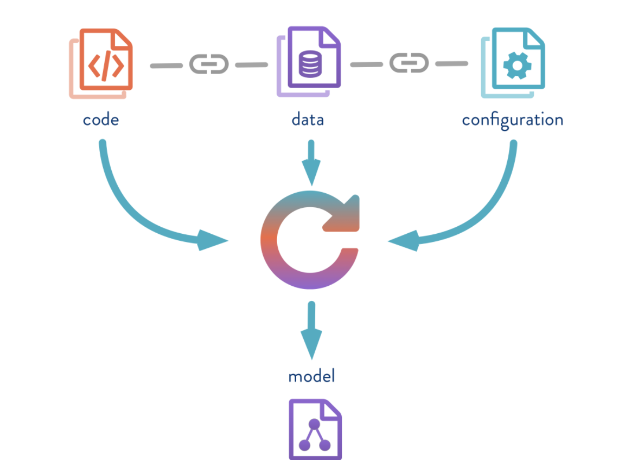
Versioning

Slide 10
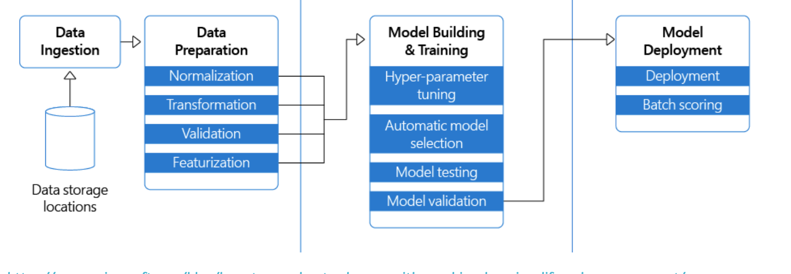
Testing
Data Validation
Model Validation

Slide 11
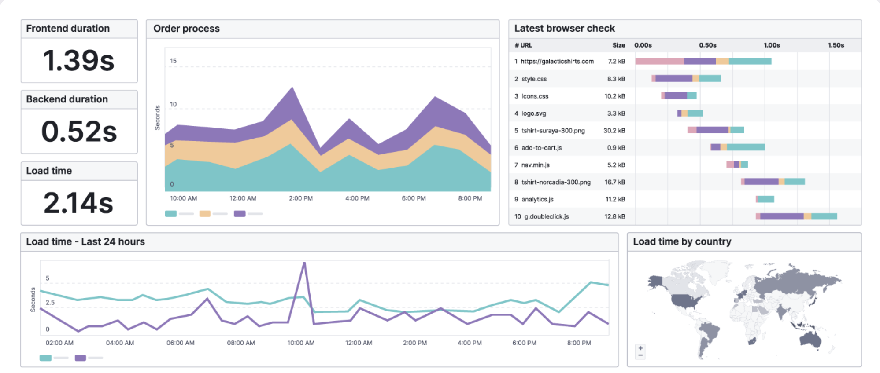
Production Monitoring

Slide 12
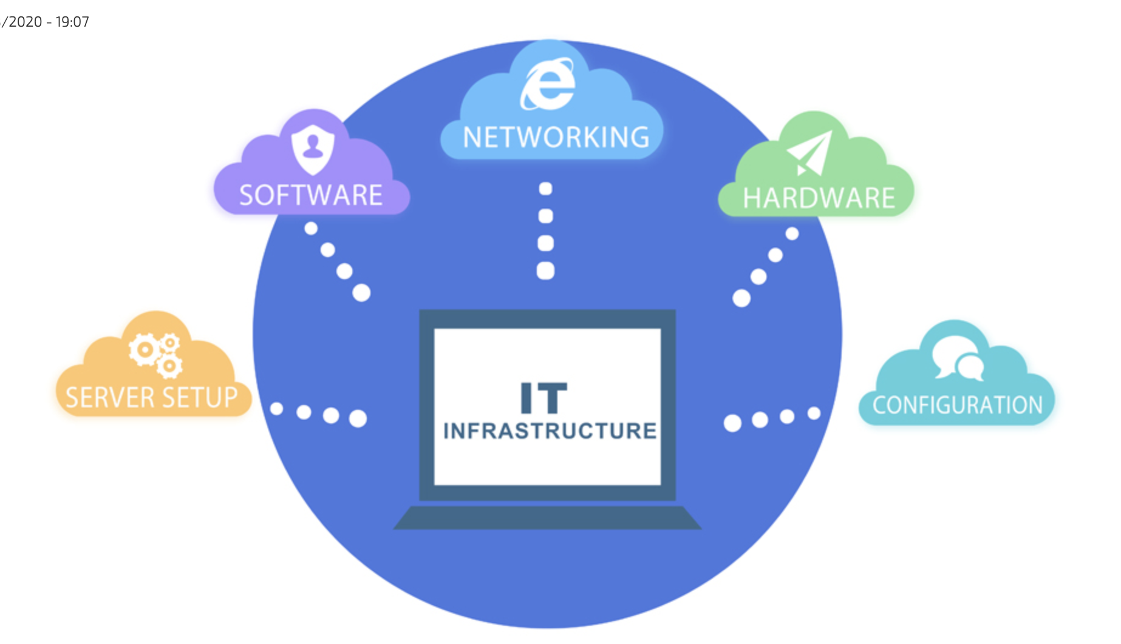
Infrastructure Requirement

Slide 13
Components
Source control
Test and build services
Deployment services
Model registry
Feature store
ML metadata store
ML pipeline orchestrator

Slide 14





Tools

Slide 15
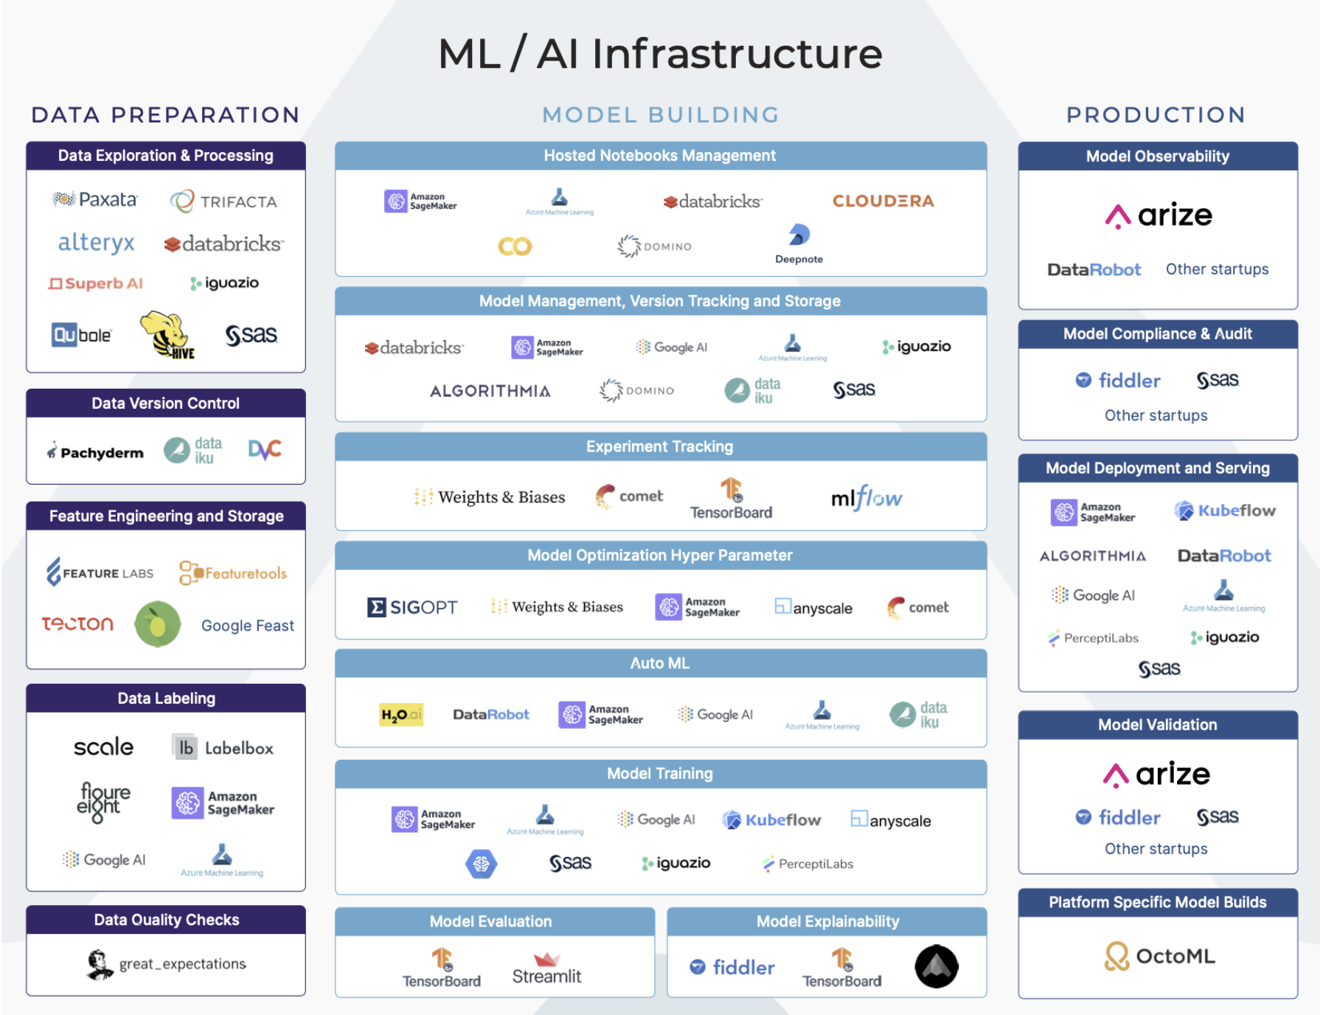

Slide 16

Questions?

